Slide 1
AI for Kids
Manal Helal

Slide 2
Outline
Give Students a pre-questionnaire about their dream jobs, their perception of the current state of AI, and their past experiences with it.
Then Give them free time to experiment with Generative AI models, particularly in object detection, free chat in text and voice, and free generative AI image creation to create storyboards of their imagination
Then Give the following slides
Then, a final questionnaire about their dream jobs now, their current perception of AI and its capabilities, how it can change the world, and what that means for them as they study.

Slide 3
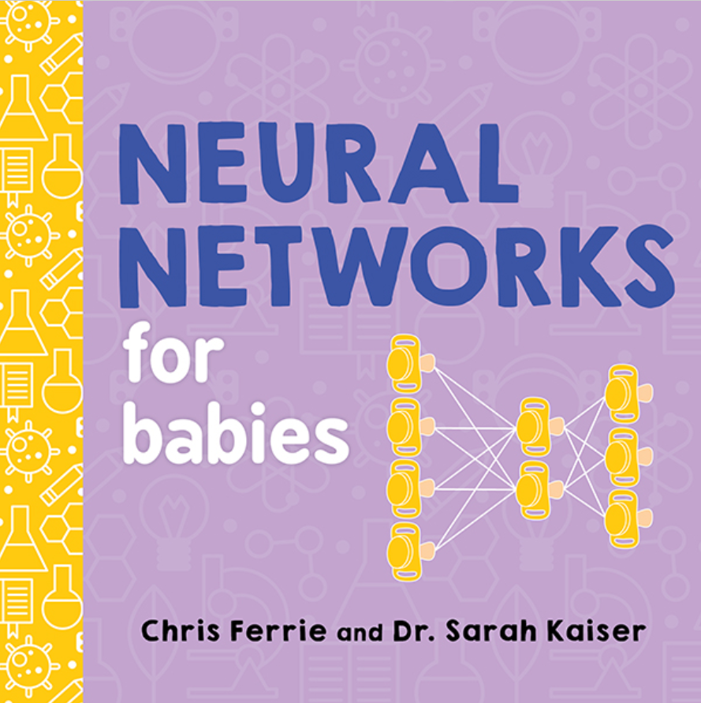
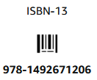
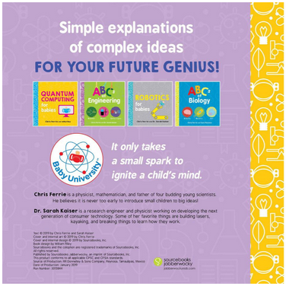
Artificial Neural Networks Behind AI latest advances
The book presented
From a nice series
Notes:
NOTE: To change images on this slide, select a picture and delete it. Then click the Insert Picture icon in the placeholder to insert your own image.

Slide 4
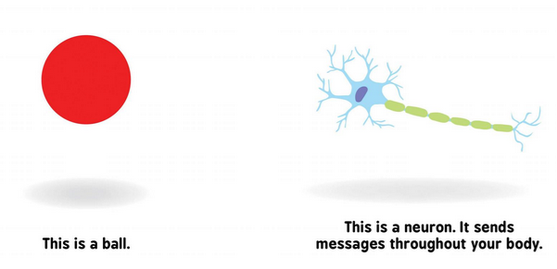
Your eye (sensor) passes it to the brain when you see something. A neuron will be activated.
Notes:
NOTE: To change images on this slide, select a picture and delete it. Then click the Insert Picture icon in the placeholder to insert your own image.

Slide 5
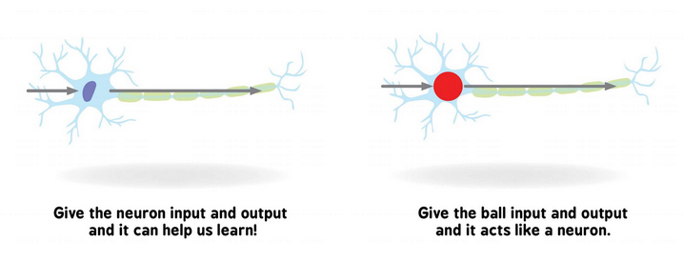
The neuron tries to understand and can activate another neuron (maybe a memory of other images you saw before) to learn the description of the image.

Slide 6
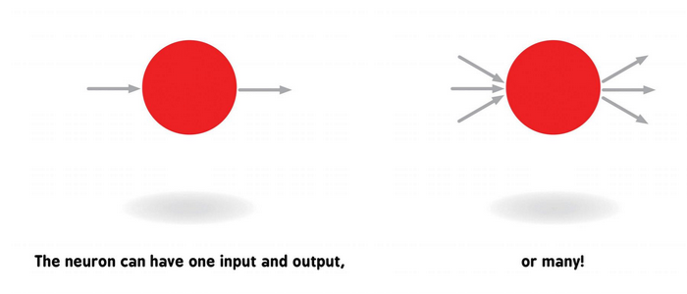
One neuron can be activated by one input or more. The neuron outputs one or more outputs to activate another one more neurons. Maybe you saw a lion and need to activate your legs to run out of there.

Slide 7
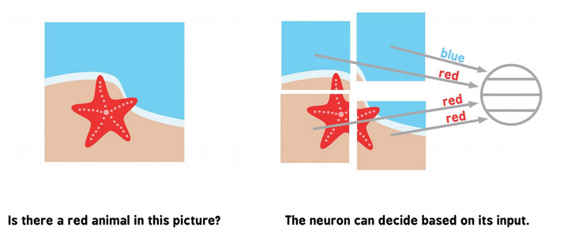
Trying to understand what you saw, your neurons divide any scene into partitions and label each

Slide 8
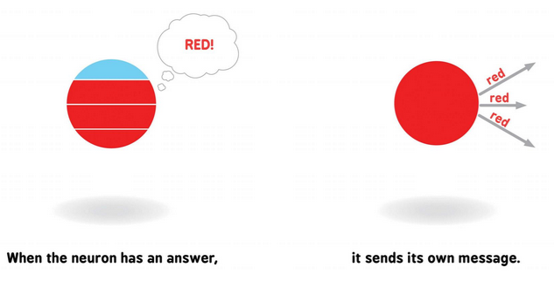
All labels/descriptions of the scene partitions in one neuron, decide its one or more outputs

Slide 9
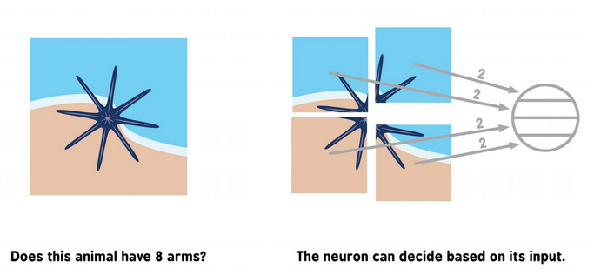
Weighting these inputs and outputs with your prior knowledge, your brain decide the scene contents

Slide 10
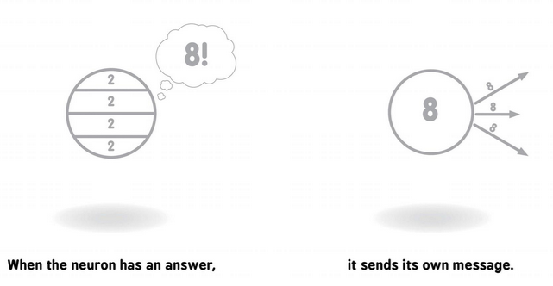
The answer from one neuron is sent to another neuron or more

Slide 11
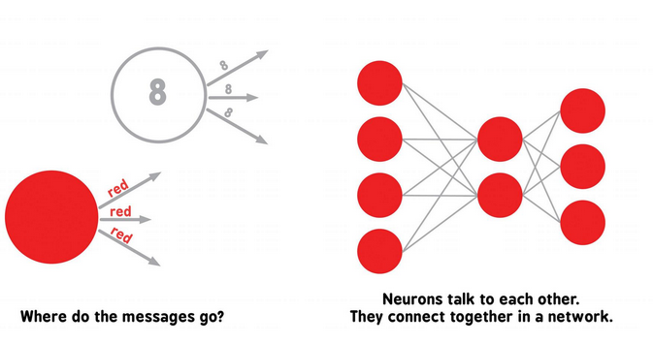
Many neurons talk to many neurons in your body to see, move, talk, learn and everything

Slide 12
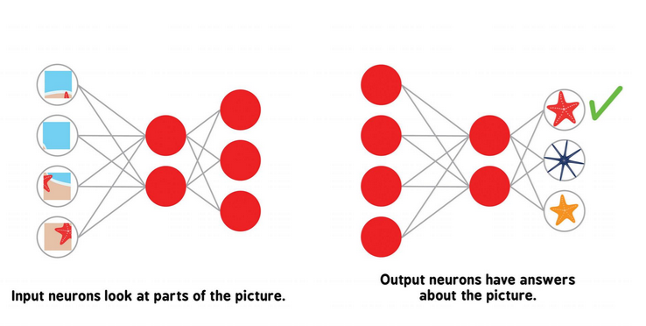
You know lots of things; when you see a red 5-arm star, your brain decides that it is a red 5-arm star, not the yellow, and not the 8-arms or other labels that you know.

Slide 13
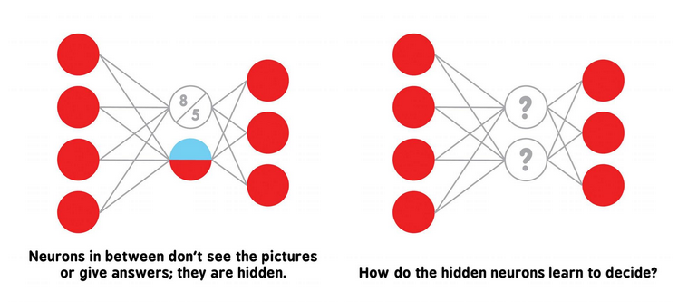
Every connected neuron from your eye to your brain shares its decision/output to other many hidden neurons until you say/output the label of the scene you saw.

Slide 14
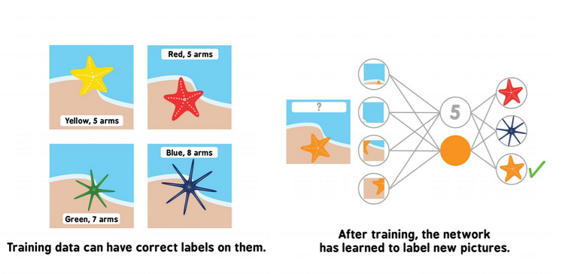
Babies are born not knowing the names/labels of things around them. They are trained by parents, then teachers the name of everything (training dataset) to keep in their memory and identify them when they see it again.

Slide 15
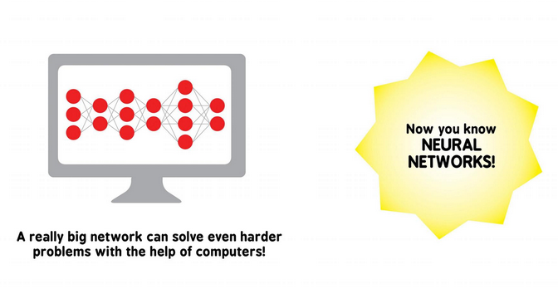
Computers learn like you learn, by building massive large networks of neurons.

Slide 16
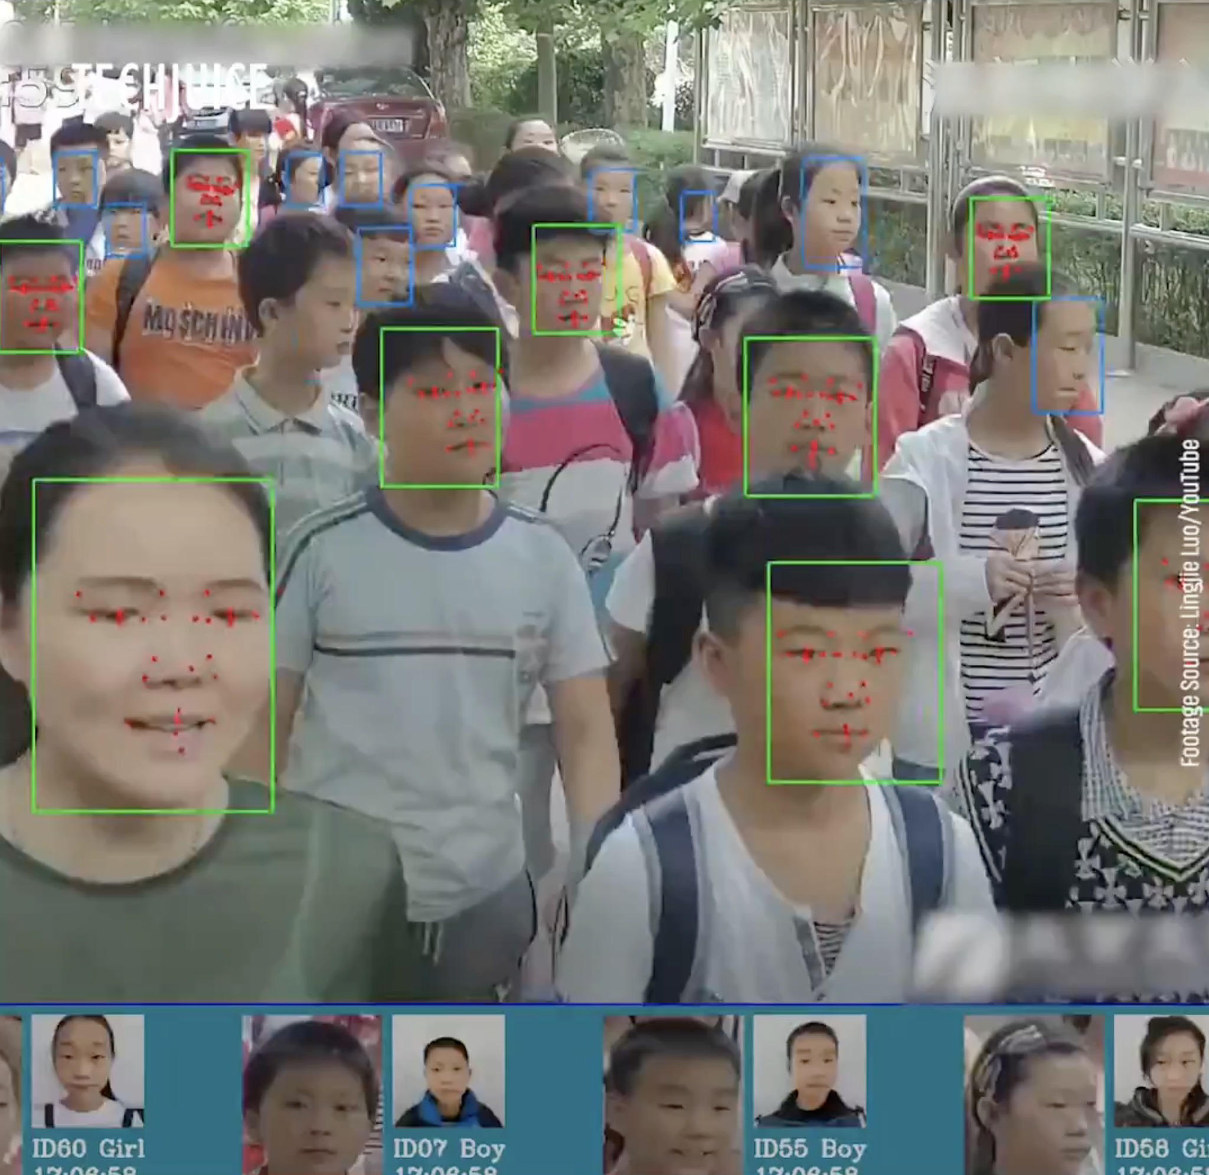
From 2013: Artificial Neural Networks (ANN) now remember people's faces and label them with their names, and many animals and objects around us.
Image credit: https://www.eecs.yorku.ca/~kosta/Courses/EECS6322/

Slide 17
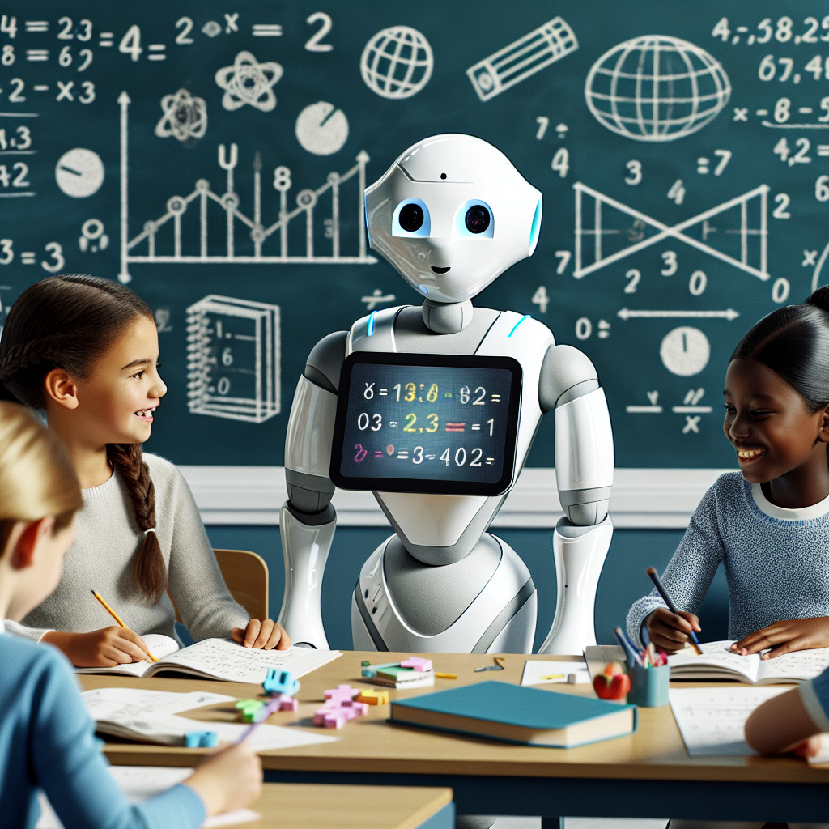
Computers are now trained on so many human faces that they can generate new faces that do not exist around us.

Slide 18
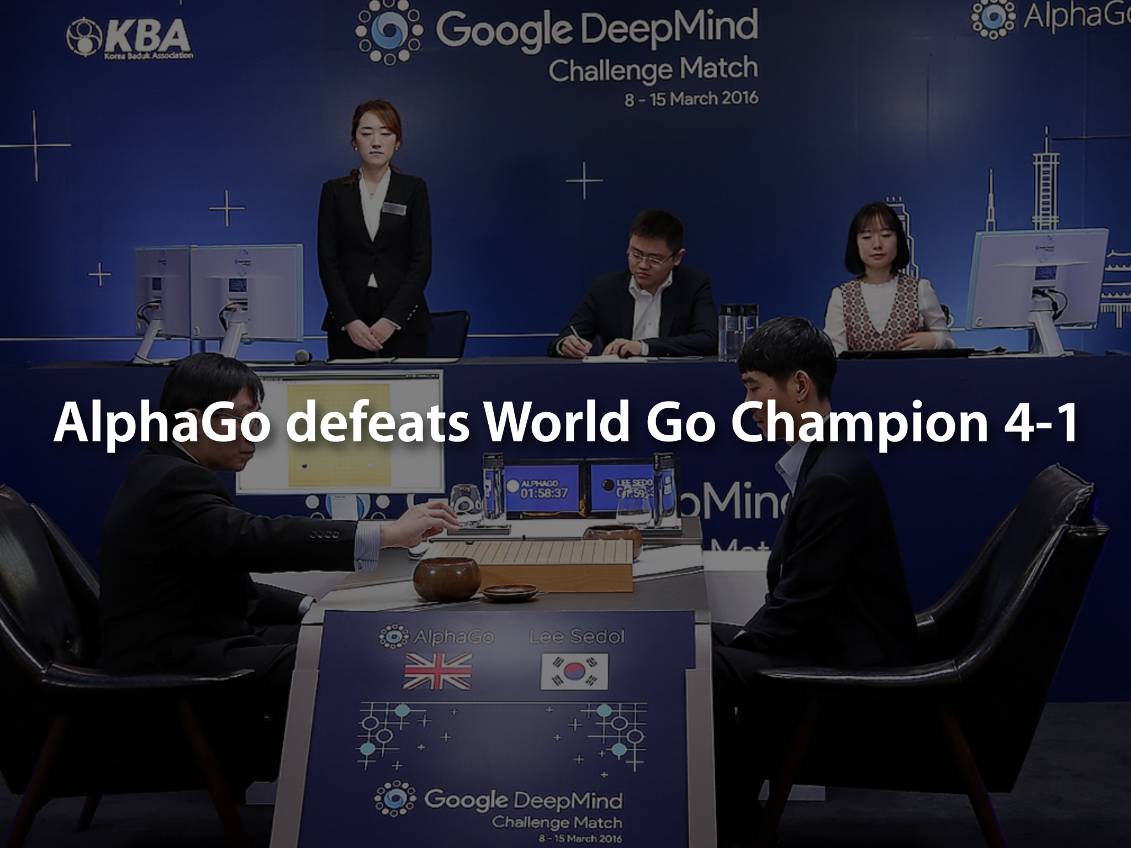
In 2016, computers learned how to play games and won against the Human World Champion and continue to do better in many games and tasks.
Image credit: https://www.eecs.yorku.ca/~kosta/Courses/EECS6322/

Slide 19
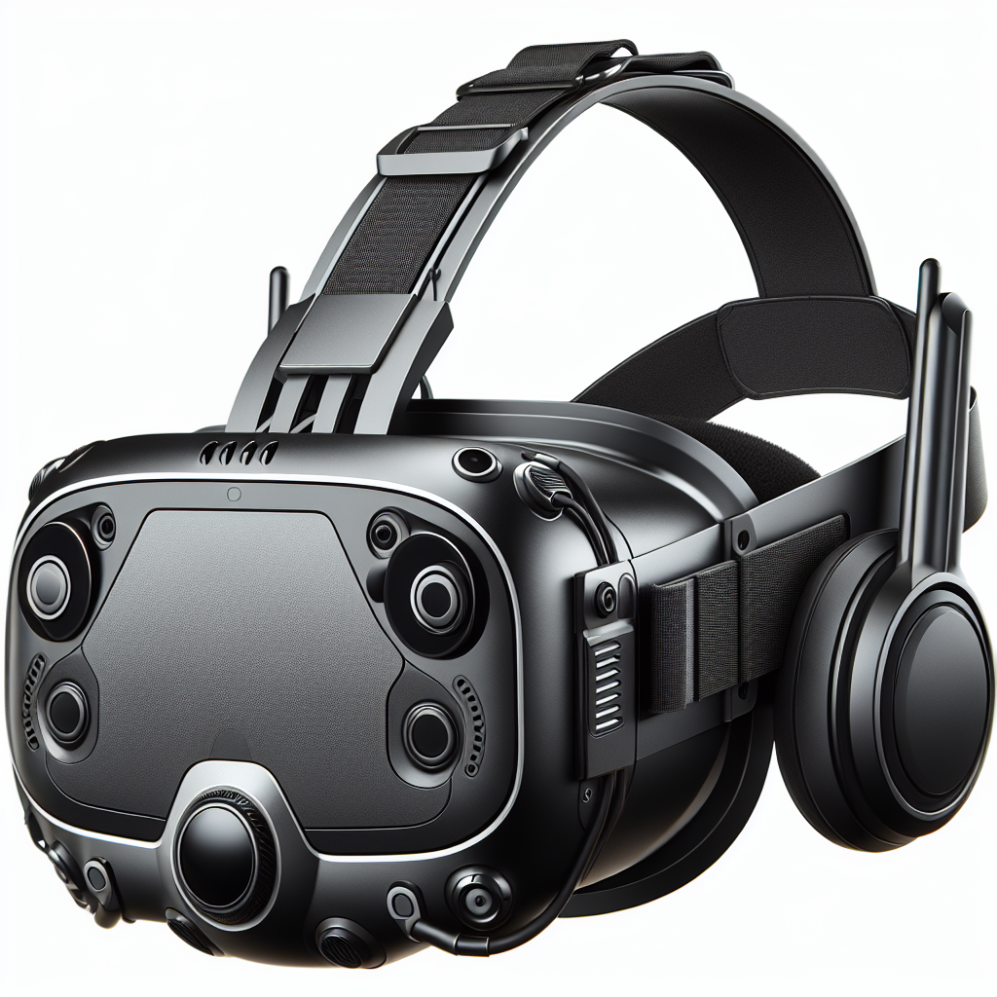
People can wear devices to see and remember things for them and, similarly, to hear from the different devices that decide the labels and decisions for them.

Slide 20
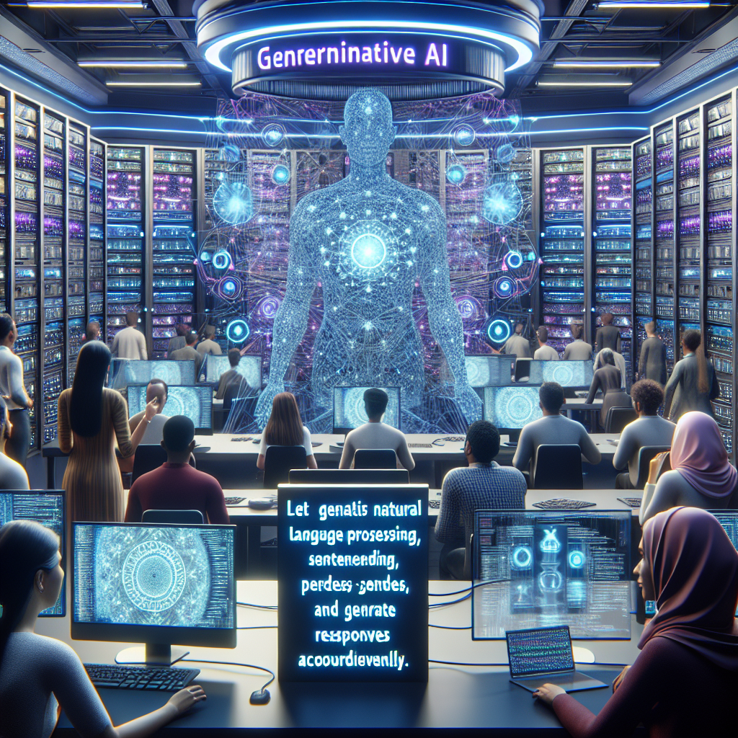
Computers learn so much text written in many books and on the internet that they can also generate new conversations with humans like humans can together.

Slide 21
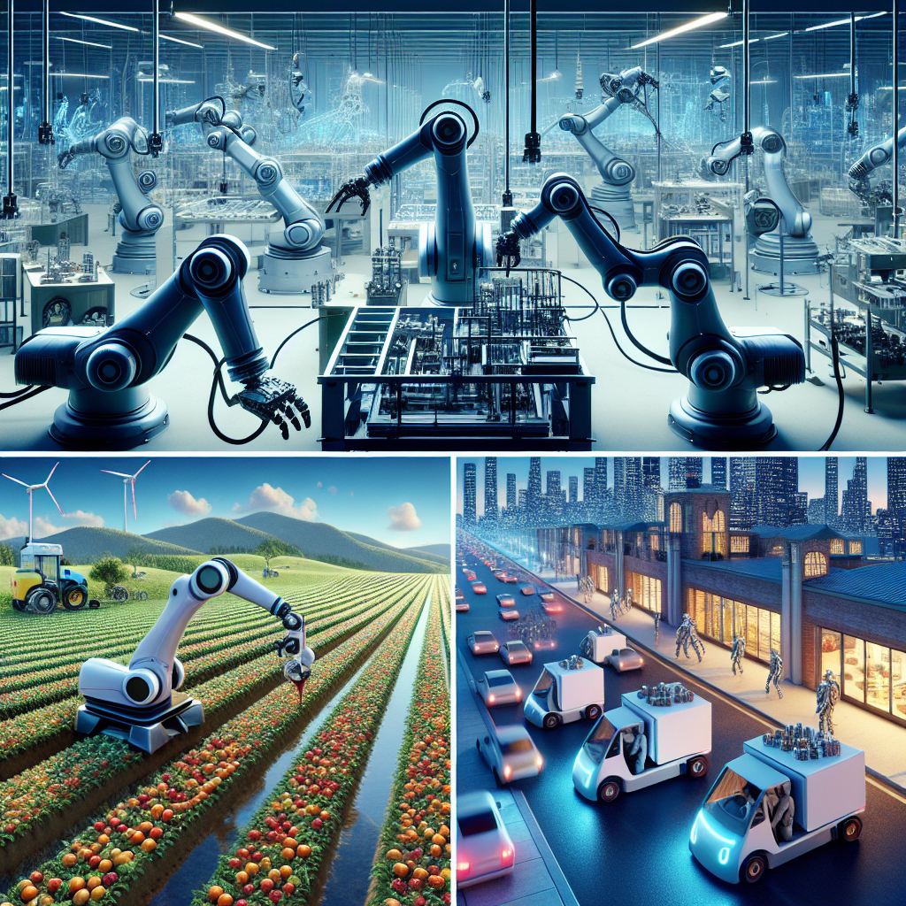
Many Jobs done by humans are now done by robots, particularly in manufacturing, farming, logistics and delivery

Slide 22
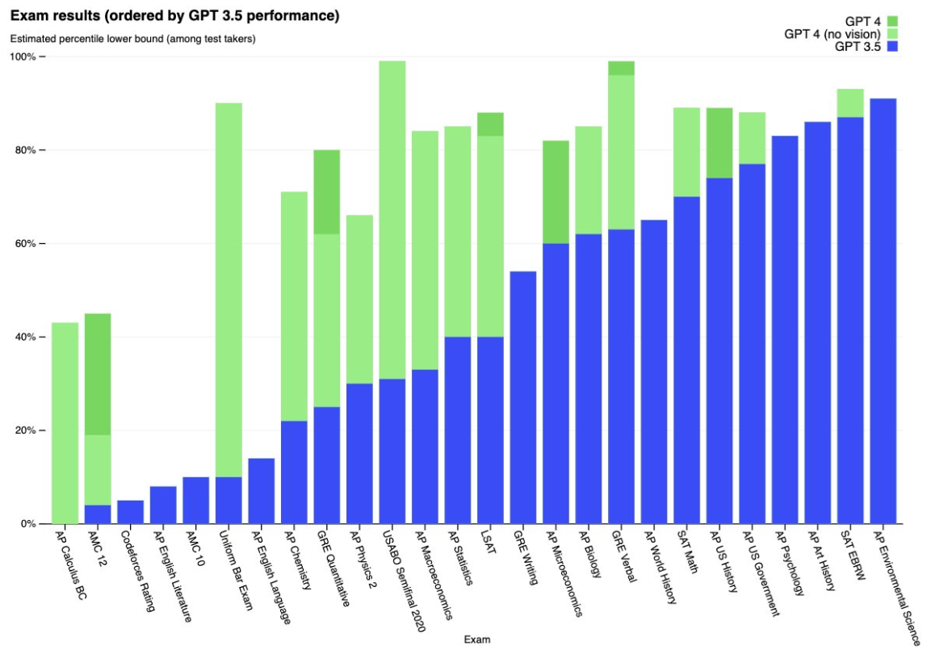
47 and 56% of all Jobs tasks can finish faster using AI
Job titles | AI Impact
Postdoc | 5%
Pre K Teacher | 5%
Preschool Teacher | 5%
Primary Teacher | 5%
Private Tutor | 5%
Professional Tutor | 5%
Psychology Instructor | 5%
Psychology Professor | 5%
Psychology Teacher | 5%
Reader | 5%
Reading Teacher | 5%
Reading Tutor | 5%
Religion Teacher | 5%
Job titles | AI Impact
Communications Manager | 98%
Data Collector | 95%
Data Entry | 95%
Mail Clerk | 95%
Compliance Officer | 92%
Chief Executive Officer (CEO) | 91%
Therapist | 90%
Chief Strategy Officer | 90%
Admin | 90%
General Clerk | 90%
Mail Handler | 90%
Data Clerk | 90%
Data Entry Clerk | 90%
65% of today’s children will be working in jobs not yet created.
N. Perucica, “Our children are growing up with AI:
what you need to know,” Jan. 2022. [Online]. Available: https://www.weforum.org/agenda/2022/01/artificial-intelligence-children-technology/
Eloundou, T., Manning, S., Mishkin, P., Rock, D.: GPTs are GPTs: An Early
Look at the Labor Market Impact Potential of Large Language Models. https:
//doi.org/10.48550/arXiv.2303.10130 . https://arxiv.org/pdf/2303.10130.pdf

Slide 23
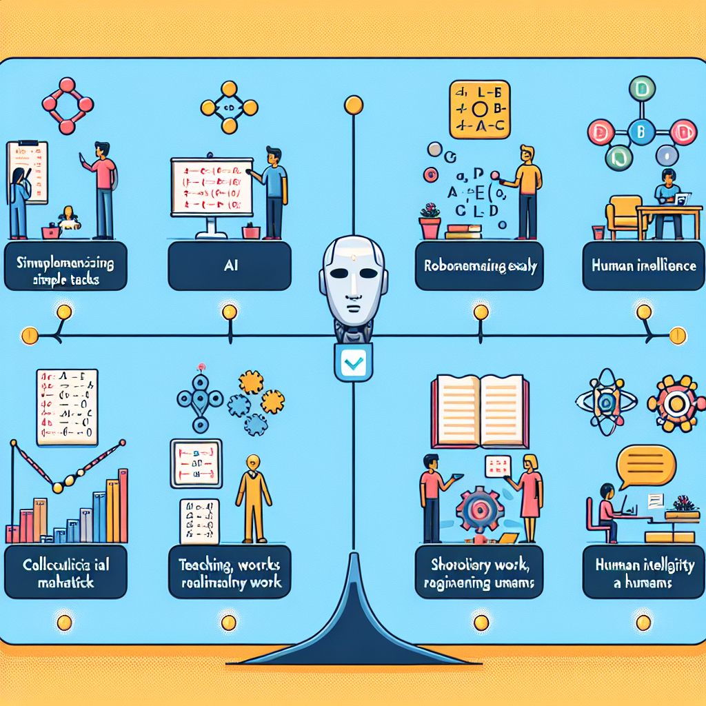
Observations: Simple Tasks and exams that require memorising lots of details are better done by AI and Robots. Complex tasks or human support tasks (teaching, scholarly and spiritual) are not impacted by AI in jobs, and calculus and reasoning exams are not passed easily by AI and need human intelligence.

Slide 24
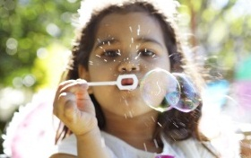
Ask students about the job they need to specialise in as they grow up? Get them to experiment with the state of the Art AI capabilities today Give them this presentation Ask again about the job that they wish to have in the current AI developments. Do you think Artificial Intelligence (AI) is better than Human Intelligence (ours)? Should we stop learning because computers will learn for us?
The Questionnaire
Notes:
NOTE: To change images on this slide, select a picture and delete it. Then click the Insert Picture icon in the placeholder to insert your own image.

Slide 25
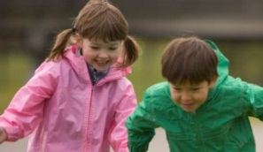
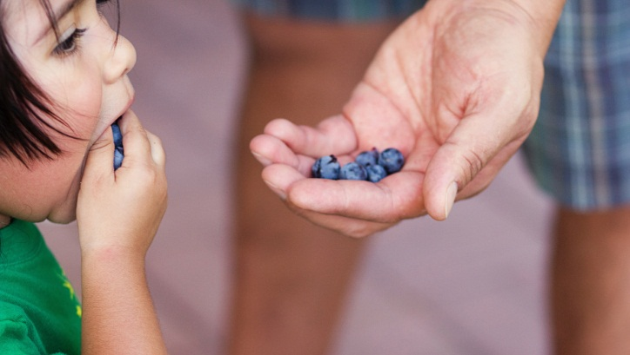
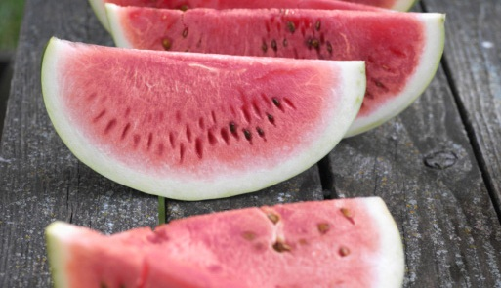
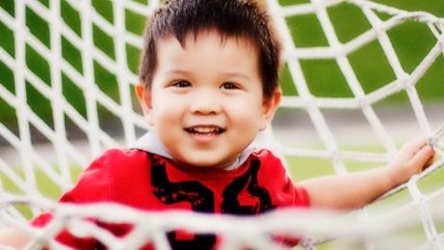
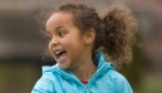
Five pictures
Notes:
NOTE: To change images on this slide, select a picture and delete it. Then click the Insert Picture icon in the placeholder to insert your own image.

